Slide 1
Chapter 11: Phasors and Complex Numbers (Part 2)
Complex Numbers

Slide 2
Objectives
After completing Part 2 of this chapter, you should be able to :
Use a phasor to represent a sine wave
Use complex numbers to represent phasor quantities
Perform mathematical calculations using rectangular and polar forms
Convert a number in polar form to rectangular form and vice versa
Determine the total output voltage of several ac voltage sources connected in series

Slide 3
11-2 Complex Number System
Phasors in their graphical form, however, are not easy to manipulate
They can be converted into a Complex number system that allows them to be expressed mathematically
In the complex number form, phasor quantities can be easily added, subtracted, multiplied, or divided
Useful in analysis of ac circuits

Slide 4
Rectangular and Polar Forms
Rectangular form and Polar form are two forms of complex numbers used to represent phasor quantities
Each has certain advantages when used in circuit analysis, depending on particular application

Slide 5
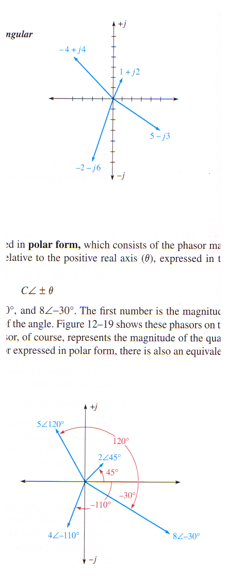
Rectangular Form
Phasor quantity in rectangular form → algebraic sum of real value (A) of coordinate and “j” value (B) of coordinate
Expressed as:
A + j B

Slide 6
Polar Form
Phasor quantities in polar form → consists of phasor magnitude (C) and the angular position relative to the positive real axis (θ)
Expressed as:
C ∠ ± θ

Slide 7



Mathematical Operations
Addition & Subtraction
Complex numbers must be in rectangular form in order to perform addition or subtraction
Examples on addition:
Examples on subtraction:

Slide 8



Multiplication (or Division)
The rule is: With both numbers in polar form, multiply (or divide) the magnitudes, and add (or subtract) the angles algebraically
Examples of Multiplication
Example of Division

Slide 9
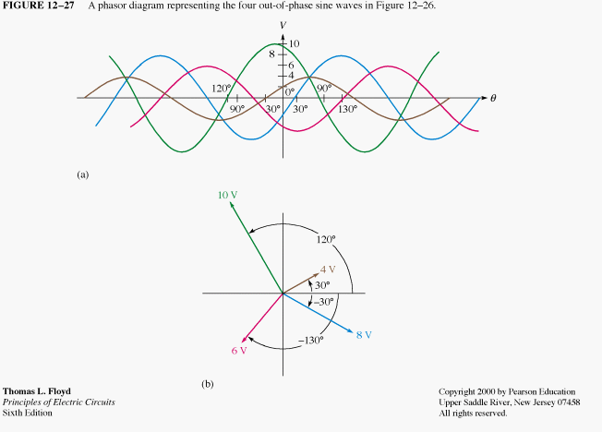
Using Complex Numbers with Sine waves
V1
V2
V3
V4
The time domain expressions for the 4 sinusoidal ac voltages are :
Expressing in
polar form using
peak voltages
v₁ = 10 sin (ωt + 120º)
v_{1(peak)} = 10∠120º
v₂ = 4 sin (ωt + 30º)
v_{2(peak)} = 4∠30º
v₃ = 8 sin (ωt - 30º)
v_{3(peak)} = 8∠-30º
v₄ = 6 sin (ωt - 130º)
v_{4(peak)} = 6∠-130º

Slide 10
The phasor diagram that describe the four sinusoidal ac voltage sources is :
V_{1(peak)} = 10∠120º V_{2(peak)} = 4∠30º
V_{3(peak)} = 8∠-30º V_{4(peak)} = 6∠-130º

Slide 11
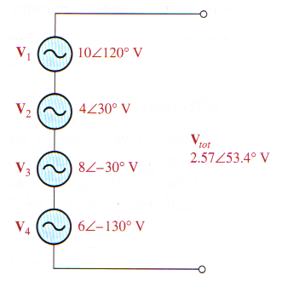
If the four sinusoidal ac voltage sources are connected in series, the total voltage can be determined by adding the sinusoidal ac voltage sources using phasors as follows:
V_{tot (peak)} = V_{1(peak)} + V_{2(peak)} + V_{3(peak)} + V_{4(peak)}
= 10∠120º + 4∠30º + 8∠-30º + 6∠-130º
= (-5 + j8.66) + (3.46 + j2) + (6.93 – j4) + (-3.86 – j4.6)
= (1.53 + j2.06) V
= 2.57∠53.4º V
v_{tot} = 2.57 sin (ωt + 53.4º) V

Slide 12
Important Note
In the preceding examples, the magnitudes of the phasors are expressed in peak values of the sinusoidal ac voltages.
However, sinusoidal AC waves are usually defined by the RMS values of the ac voltages and currents.
Thus, magnitudes of phasors may also be expressed in RMS values.
In AC circuit analysis, the magnitude portion of a phasor will be taken to represent the RMS Value of an AC voltage or current unless otherwise specified

Slide 13
Summary
A phasor diagram can be drawn to represent a sine wave.
The angular position of the phasor represents angle of sine wave with respect to a reference, and length of a phasor represents the amplitude.
A phasor diagram can also be used to show the phase relationship between 2 or more sinusoidal quantities.
The complex number system can be used to represent a phasor quantity.

Slide 14
Summary
Rectangular form of a complex number consists of a real part and a j part of the form A + j B.
The polar form of a complex number consists of a magnitude and an angle of the form C ±θ

Slide 15
End of Chapter 11

